Slide 1
Discrete Mathematics and Its Application 7th edition, 2001
Kenneth H. Rosen

Slide 2
Welcome to Discrete Mathematics Spring 2018
Instructor: Niu Shao Zhang

Slide 3
§4.1 Divisibility and Modular Arithmetic
Section Summary
Division(除法)
Division Algorithm
Modular Arithmetic（模运算）

Slide 4
§4.2 Integer Representations and Algorithms
Section Summary
Integer Representations
Base b Expansions
Binary Expansions
Octal Expansions
Hexadecimal Expansions
Base Conversion Algorithm
Algorithms for Integer Operations

Slide 5
Representations of Integers
In the modern world, we use decimal, or base 10, notation to represent integers. For example when we write 965, we mean 9∙10² + 6∙10¹ + 5∙10⁰ .
We can represent numbers using any base b, where b is a positive integer greater than 1.
The bases b = 2 (binary), b = 8 (octal) , and b= 16 (hexadecimal) are important for computing and communications
The ancient Mayans(玛雅人) used base 20 and the ancient Babylonians used(巴比伦人) base 60.

Slide 6
Base b Representations
We can use positive integer b greater than 1 as a base, because of this theorem:
Theorem 1: Let b be a positive integer greater than 1. Then if n is a positive integer, it can be expressed uniquely in the form:
n = a_{k}b^{k} + a_{k-1}b^{k-1} + …. + a₁b + a₀
where k is a nonnegative integer, a₀,a₁,…. a_{k} are nonnegative integers less than b, and a_{k}≠ 0. The a_{j}, j = 0,…,k are called the base-b digits of the representation.
The representation of n given in Theorem 1 is called the base b expansion of n and is denoted by (a_{k}a_{k-1}….a₁a₀)_{b}.
We usually omit the subscript 10 for base 10 expansions.

Slide 7
Binary Expansions
Most computers represent integers and do arithmetic with binary (base 2) expansions of integers. In these expansions, the only digits used are 0 and 1.
Example: What is the decimal expansion of the integer that has (1 0101 1111)₂ as its binary expansion?
Solution:
(1 0101 1111)₂ = 1∙2⁸ + 0∙2⁷ + 1∙2⁶ + 0∙2⁵ + 1∙2⁴ + 1∙2³ + 1∙2² + 1∙2¹ + 1∙2⁰ =351.
Example: What is the decimal expansion of the integer that has (11011)₂ as its binary expansion?
Solution: (11011)₂ = 1 ∙2⁴ + 1∙2³ + 0∙2² + 1∙2¹ + 1∙2⁰ =27.

Slide 8
Octal Expansions
The octal expansion (base 8) uses the digits {0,1,2,3,4,5,6,7}.
Example: What is the decimal expansion of the number with octal expansion (7016)₈ ?
Solution: 7∙8³ + 0∙8² + 1∙8¹ + 6∙8⁰ =3598
Example: What is the decimal expansion of the number with octal expansion (111)₈ ?
Solution: 1∙8² + 1∙8¹ + 1∙8⁰ = 64 + 8 + 1 = 73

Slide 9
Hexadecimal Expansions
The hexadecimal expansion needs 16 digits, but our decimal system provides only 10. So letters are used for the additional symbols. The hexadecimal system uses the digits {0,1,2,3,4,5,6,7,8,9,A,B,C,D,E,F}. The letters A through F represent the decimal numbers 10 through 15.
Example: What is the decimal expansion of the number with hexadecimal expansion (2AE0B)₁₆ ?
Solution:
2∙16⁴ + 10∙16³ + 14∙16² + 0∙16¹ + 11∙16⁰ =175627
Example: What is the decimal expansion of the number with hexadecimal expansion (1E5)₁₆ ?
Solution: 1∙16² + 14∙16¹ + 5∙16⁰ = 256 + 224 + 5 = 485

Slide 10
Particular Bases of Interest
Used only because we have 10 fingers
Base b=10 (decimal): 10 digits: 0,1,2,3,4,5,6,7,8,9.
Base b=2 (binary): 2 digits: 0,1. (“Bits”=“binary digits.”)
Base b=8 (octal): 8 digits: 0,1,2,3,4,5,6,7.
Base b=16 (hexadecimal): 16 digits: 0,1,2,3,4,5,6,7,8,9,A,B,C,D,E,F
Used internally in all modern computers
Octal digits correspond to groups of 3 bits
Hex digits give groups of 4 bits

Slide 11
Base Conversion
To construct the base b expansion of an integer n:
Divide n by b to obtain a quotient and remainder.
n = bq₀ + a₀ 0 ≤ a₀ ≤ b
The remainder, a₀ , is the rightmost digit in the base b expansion of n. Next, divide q₀ by b.
q₀ = bq₁ + a₁ 0 ≤ a₁ ≤ b
The remainder, a₁, is the second digit from the right in the base b expansion of n.
Continue by successively dividing the quotients by b, obtaining the additional base b digits as the remainder. The process terminates when the quotient is 0.
continued →

Slide 12
Base Conversion
Example: Find the octal expansion of (12345)₁₀
Solution: Successively dividing by 8 gives:
12345 = 8 ∙ 1543 + 1
1543 = 8 ∙ 192 + 7
192 = 8 ∙ 24 + 0
24 = 8 ∙ 3 + 0
3 = 8 ∙ 0 + 3
The remainders are the digits from right to left yielding (30071)₈.

Slide 13
Algorithm: Constructing Base b Expansions
procedure base b expansion(n, b: positive integers with b > 1)
q := n
k := 0
while (q ≠ 0)
a_{k} := q mod b
q := q div b
k := k + 1
return(a_{k-1} ,…, a₁,a₀){(a_{k-1} … a₁a₀)_{b} is base b expansion of n}
q represents the quotient obtained by successive divisions by b, starting with q = n.
The digits in the base b expansion are the remainders of the division given by q mod b.
The algorithm terminates when q = 0 is reached.

Slide 14
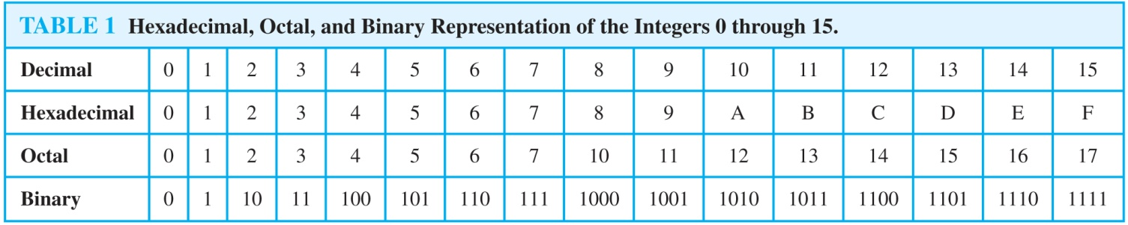
Comparison of Hexadecimal, Octal, and Binary Representations
Initial 0s are not shown
Each octal digit corresponds to a block of 3 binary digits.
Each hexadecimal digit corresponds to a block of 4 binary digits.
So, conversion between binary, octal, and hexadecimal is easy.

Slide 15
Conversion Between Binary, Octal, and Hexadecimal Expansions
Example: Find the octal and hexadecimal expansions of (11 1110 1011 1100)₂.
Solution:
To convert to octal, we group the digits into blocks of three (011 111 010 111 100)₂, adding initial 0s as needed. The blocks from left to right correspond to the digits 3,7,2,7, and 4. Hence, the solution is (37274)₈.
To convert to hexadecimal, we group the digits into blocks of four (0011 1110 1011 1100)₂, adding initial 0s as needed. The blocks from left to right correspond to the digits 3,E,B, and C. Hence, the solution is (3EBC)₁₆.

Slide 16
Binary Addition of Integers
Algorithms for performing operations with integers using their binary expansions are important as computer chips work with binary numbers. Each digit is called a bit.
The number of additions of bits used by the algorithm to add two n-bit integers is O(n).
procedure add(a, b: positive integers)
{the binary expansions of a and b are (a_{n-1},a_{n-2},…,a₀)₂ and (b_{n-1},b_{n-2},…,b₀)₂, respectively}
c := 0
for j := 0 to n − 1
d := ⌊(a_{j} + b_{j} + c)/2⌋
s_{j} := a_{j} + b_{j} + c − 2d
c := d
s_{n} := c
return(s₀,s₁,…, s_{n}){the binary expansion of the sum is (s_{n},s_{n-1},…,s₀)₂}

Slide 17
Addition of Binary Numbers
procedure add(a_{n−1}…a₀, b_{n−1}…b₀: binary representations of non-negative integers a,b)
carry := 0
for bitIndex := 0 to n−1 {go through bits}
bitSum := a_{bitIndex}+b_{bitIndex}+carry {2-bit sum}
s_{bitIndex} := bitSum mod 2 {low bit of sum}
carry := ⎣bitSum / 2⎦ {high bit of sum}
s_{n} := carry
return s_{n}…s₀: binary representation of integer s
Notes:
Show 3-input full adder truth table on board.
Have students try this or one of the following algorithms by hand.

Slide 18
Binary Multiplication of Integers
Example
Find the product of a=110 and b=101?
Solution:
110
101
110
000
110
11110

Slide 19
Binary Multiplication of Integers
Algorithm for computing the product of two n bit integers.
The number of additions of bits used by the algorithm to multiply two n-bit integers is O(n²).
procedure multiply(a, b: positive integers)
{the binary expansions of a and b are (a_{n-1},a_{n-2},…,a₀)₂ and (b_{n-1},b_{n-2},…,b₀)₂, respectively}
for j := 0 to n − 1
if b_{j} = 1 then c_{j} = a shifted j places
else c_{j} := 0
{c_{o},c₁,…, c_{n-1} are the partial products}
p := 0
for j := 0 to n − 1
p := p + c_{j}
return p {p is the value of ab}

Slide 20
Binary Division with Remainder
procedure division algorithm(a ∈ Z,d ∈ Z⁺)
q := 0
r := |a|
while r ≥ d
r := r − d
q := q + 1
if a <0 and r>0 then
r := d – r
q := – (q+1)
return q,r {q = quotient, r = remainder}
O(q log a)

Slide 21
Modular Exponentiation Problem
Problem: Given large integers b (base), n (exponent), and m (modulus), efficiently compute b^{n} mod m.
Note that b^{n} itself may be completely infeasible to compute and store directly.
E.g. if n is a 1,000-bit number, then b^{n} itself will have far more digits than there are atoms in the universe!
Yet, this is a type of calculation that is commonly required in modern cryptographic algorithms!

Slide 22
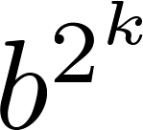
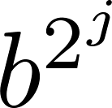
Binary Modular Exponentiation
In cryptography, it is important to be able to find b^{n} mod m efficiently, where b, n, and m are large integers.
Use the binary expansion of n, n = (a_{k-1},…,a₁,a_{o})₂ , to compute b^{n} .
Note that:
Therefore, to compute b^{n}, we need only compute the values of b, b², (b²)² = b⁴, (b⁴)² = b⁸ , …, and the multiply the terms in this list, where a_{j} = 1.
Example: Compute 3¹¹ using this method.
Solution: Note that 11 = (1011)₂ so that
3¹¹ = 3⁸ 3² 3¹ = ((3²)² )² 3² 3¹ = (9² )² ∙ 9 ∙3 = (81)² ∙ 9 ∙3
=6561 ∙ 9 ∙3 =117,147.

Slide 23
Why that Algorithm Works
The binary expansion of n
Note that:
We can compute b to various powers of 2 by repeated squaring.
Then multiply them into the partial product, or not, depending on whether the corresponding n_{i} bit is 1.
Crucially, we can do the mod m operations as we go along, because of the various identity laws of modular arithmetic. – All the numbers stay small.
= b¹ = b

Slide 24
Modular Exponentiation
procedure modularExponentiation(b: integer, n = (n_{k−1}…n₀)₂, m: positive integers) x := 1 {result will be accumulated here} := b mod m { mod m; i=0 initially} for i := 0 to k−1 {go thru all k bits of n} if n_{i} = 1 then x := (x· ) mod m := ( · ) mod m return x
O((logm)²logn)

Slide 25
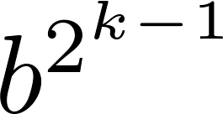
Binary Modular Exponentiation Algorithm
The algorithm successively finds b mod m, b² mod m, b⁴ mod m, …, mod m, and multiplies together the terms where a_{j} = 1.
O((log m )² log n) bit operations are used to find b^{n} mod m.
procedure modular exponentiation(b: integer, n = (a_{k-1}a_{k-2}…a₁a₀)₂ , m: positive integers)
x := 1
power := b mod m
for i := 0 to k − 1
if a_{i}= 1 then x := (x∙ power ) mod m
power := (power∙ power ) mod m
return x {x equals b^{n} mod m }

Slide 26
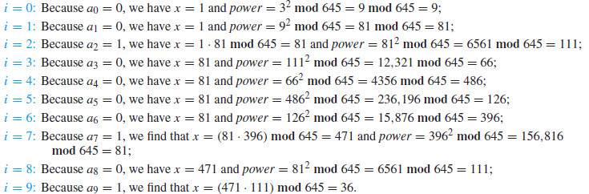
Example 12
Use Algorithm 5 to find 3⁶⁴⁴ mod 645.
644=(1010000100)₂

Slide 27
Homework
§4.2
26

